Slide 1
Real-world cryptography – SSL/TLS
Joshua Davies
Director of Architecture – 2Xoffice
Author of “Implementing SSL/TLS Using Cryptography and PKI”

Slide 2
Outline
Cryptographic concepts
  Symmetric Cryptography
  Public-key cryptography
  Digital Signatures
  Certificates
SSL/TLS
  Handshake
  Advanced/optional components

Slide 3
Digital Security
Privacy
Integrity
Authentication
Authorization
Non-repudiation (I can prove you did it)

Slide 4
Privacy - Encryption
C = E_{k}(P), P = D_{k}(C); K is a secret parameter
Ciphers: standard algorithms such as DES, 3DES, AES, RC4, Blowfish, IDEA – hundreds more
SSL/TLS provisionally supports any cipher
Most implementations support DES, 3DES, AES and RC4
Called symmetric because the same key is used for encryption and decryption

Slide 5
DES
Oldest digital cipher still in use
Developed by IBM for the NSA in 1974
Fixed 56-bit key size

Slide 6
DES – High level

Slide 7
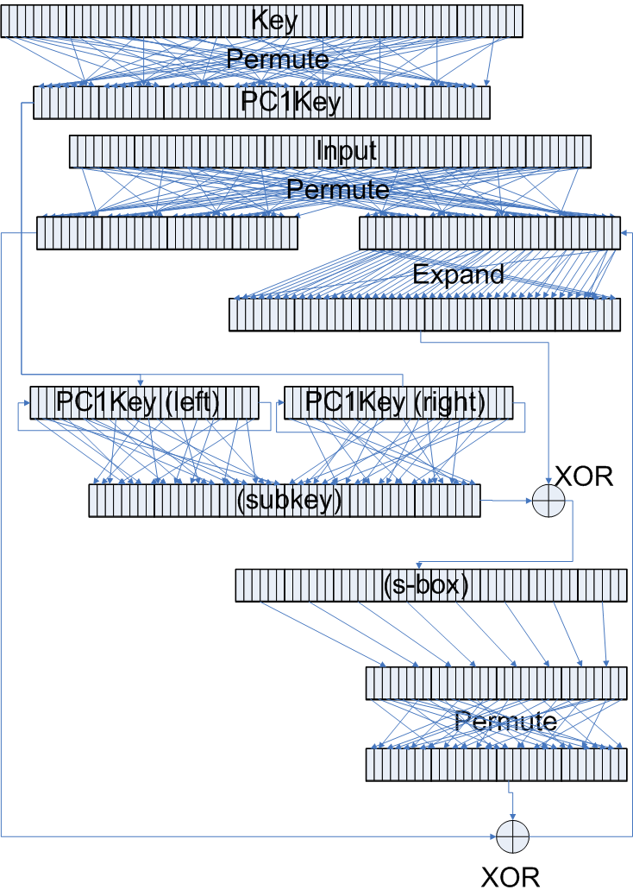
DES – One round

Slide 8
3DES
Triples DES key size by running the DES algorithm three times
Encrypt
K₁
Decrypt
K₂
Encrypt
K₃

Slide 9
Rijndael/AES
NIST started looking for a replacement for DES in 2001
Rijndael supports 128, 192 and 256-bit keys

Slide 10
AES Encryption

Slide 11
Block Ciphers and Padding
Block ciphers require exactly n bytes of input – if the plaintext is shorter, it must be padded
Padding must be done securely to avoid giving away keying material

Slide 12
Block Ciphers and CBC mode
If the plaintext block P is encrypted twice with the same key, C will be identical
Gives attacker some information on the structure of P
CBC mode XORs each block with the output of the previous block (first block is XORed with a special value called the initialization vector)

Slide 13
RC4
Stream, rather than a block, cipher
Generates a single keystream as long as the plaintext
No need for CBC or padding

Slide 14
RC4 Encryption

Slide 15
The problem with encryption – key exchange
Keys must be managed securely, but a secure channel can’t be established without a key
Public-key cryptography creates two separate keys – one for encryption, one for decryption

Slide 16
Public-key cryptography - RSA
Three numbers e, d, n such that (m^{e})^{d}%n=m
e and n are the public key, d is the private key
c = m^{e}%n
m = c^{d}%n (distributivity of modulus operator)
e, d, and n are long – at least 512 bits
Slow runtime - generally used to exchange symmetric keys

Slide 17
Diffie-Hellman Key Exchange
Virtually unused, but TLS 1.0 mandates it be supported
Can only be used for secret exchange, not for general encryption

Slide 18
Diffie-Hellman
Client
generate random a
Yc = (gª%p)
Z = Ysª%p
Server
generate random b
Ys=(g^{b}%p)
Z = Yc^{b}%p

Slide 19
Elliptic-Curve Cryptography
Relatively new, not much commercial support
Based on operations on the curve y²=x³+ax+b
Similar to Diffie-Hellman, but replaces exponentiation with elliptic curve operations
Provides similar security to Diffie-Hellman and RSA with far smaller numbers

Slide 20
Adding Points on an elliptic curve

Slide 21
Computing P₃ from P₁ and P₂
x₃=λ²-x₁-x₂
y₃=λ(x₁-x₃)-y₁
λ=(y₂-y₁)/(x₂-x₁)
Unless P₁=P₂
λ=3x₁²+a/2y₁

Slide 22
Large Number Arithmetic
Public key cryptography requires arbitrary precision math
Floating point decimals aren’t good enough, because they lose precision
Large number arithmetic takes a long time and uses a lot of memory

Slide 23
Large Number Multiplication
123
x456
738
+ 6150
+49200
56088
[(4x10³)+(5x10²)+6(10¹)]123
(4x10³)123+(5x10²)123+6(10¹)123

Slide 24
Binary Multiplication – double and add
1101
1
x1010
0
1
0
0000
1101
11010
11010
000000
110100
1101000
1101000
10000010

Slide 25
Binary Exponentiation – square and multiply
x¹⁰
xxxxxxxxxx
(xxxxx)(xxxxx)
(xxxxx)²
((xx)(xx)x)²
((xx)²x)²
(((x²)²x)²

Slide 26
Efficient, but leads to timing attacks
Each operation takes long enough that it can be measured
Missing multiplication operations allow an attacker to measure how many 1’s are in the exponent
Solution is to perform the multiplication at each step and throw the results away

Slide 27
Key exchange over an insecure channel
Client
Server
send public key pub
E_{pub}(K)
C = E_{k}(M)

Slide 28
Man-in-the middle attack
Client
Attacker
Server
send public key pub
send public key pub’
E_{pub’}(K)
E_{pub}(D_{priv’}(K))
C = E_{k}(M)
C = E_{k}(M)

Slide 29
Prove Identity through digital signatures
Upside-down public key cryptography
s = m^{d}%n
m = s^{e}%n

Slide 30
Document surrogates with secure hashes
Public-key cryptography is slow
Sign secure hashes of original documents
MD5 (128-bit)
SHA (-1=160-bit, -256, -384, -512)

Slide 31
DSA Signature generation
NIST standard for document signatures; doesn’t actually encrypt anything
k = (c%(q-1)) + 1
r = (g^{k} % p) % q
z = secure message hash
s = ((k⁻¹%q)(z+xr))%q
r and s are the signature, g, p & q are shared and public

Slide 32
DSA Signature Verification
w = s⁻¹%q
z = hash(message)
u1 = (zw) % q
u2 = (rw) % q
v = (( g^{u1}y^{u2})%p)%q
if v ≠ r, signature is rejected
Can replace exponentiation with Elliptic Curve operations to create ECDSA

Slide 33
Providing Message Integrity with HMAC
Can secure hashes be used symmetrically?

Slide 34
X.509 Certificates – distribution of public keys
Public keys are distributed in x.509 certificate files
X.509 certificates are signed by a certificate authority (CA)
CA public keys are in turn distributed as x.509 certificate files
Root CA
2nd Level CA
Certificate
Certificate
2nd Level CA
Certificate

Slide 35
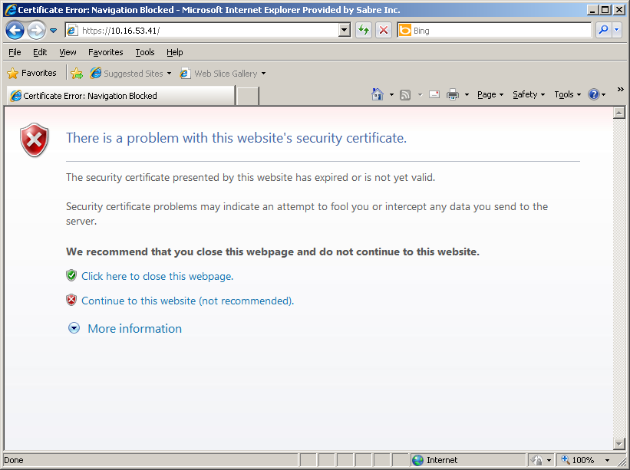
Certificate-Related Browser errors:
Certificate Expired

Slide 36
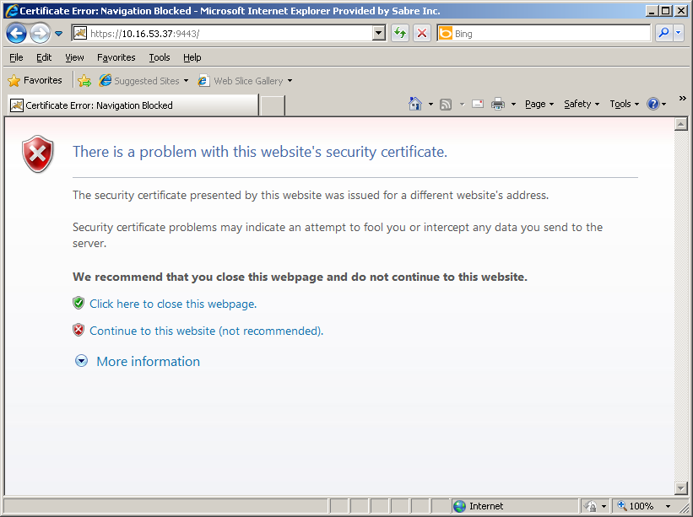
Certificate-Related Browser errors:
Domain-name mismatch

Slide 37
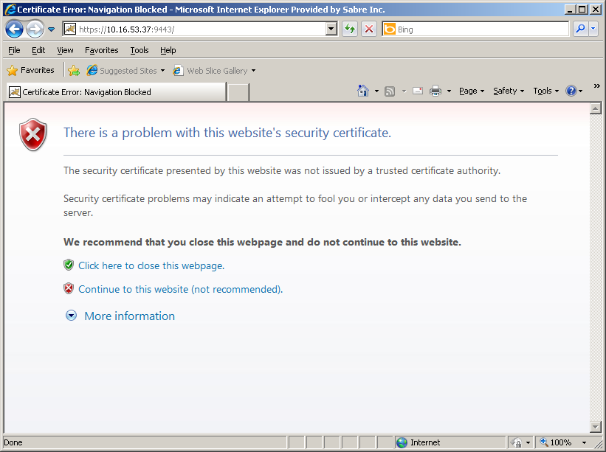
Certificate-Related Browser errors:
Untrusted Signer

Slide 38
What do all of these actually mean?
A certificate serves two primary purposes:
1) Provide a public key by which the browser and the server may exchange data securely over a public medium
2) Prove correct ownership of a website

Slide 39
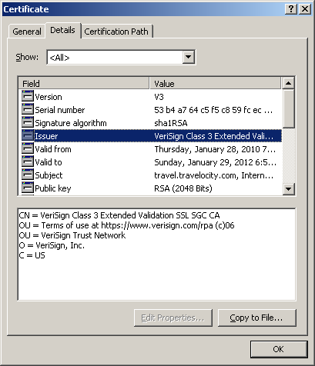
Certificate Format - Issuer

Slide 40
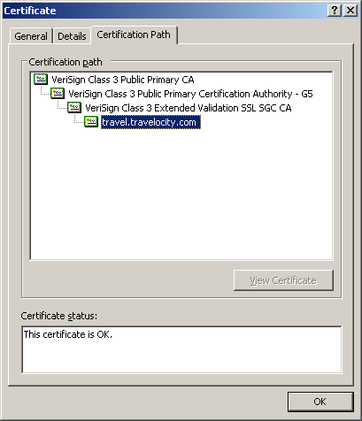
Certificate Trust Chains

Slide 41
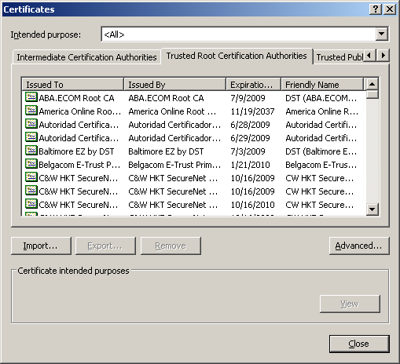
Trusted Certificate Authorities
Keep a mapping of public keys of trusted CA’s
Look up public key and validate signature on each certificate

Slide 42
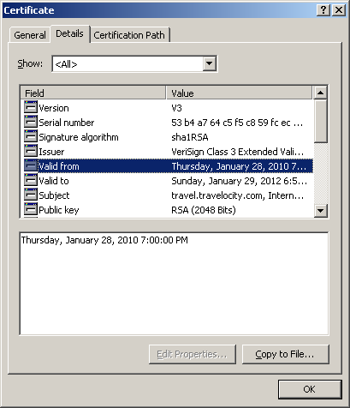
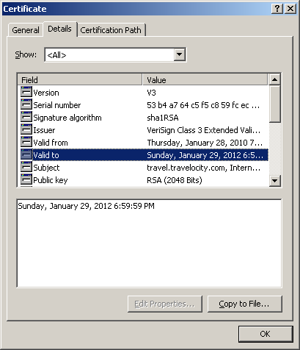
Certificate Format – Validity Period

Slide 43
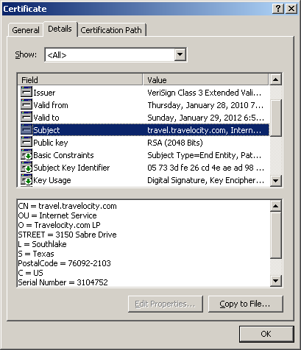
Certificate Format - Subject
Must match domain
name

Slide 44
Roles and Responsibilities
CA
Sender
Receiver
Must be done out of band
Generate Key Pair, self sign
Store CA key
Generate Key Pair
Distribute certificate
Must be done out of band
Wrap in CSR
Verify Info, Sign Certificate
Distribute Signed Cert
Validate CA Signature
Sign with private key
Verify Signature

Slide 45
Putting it all together – SSL handshake
Client
Server
Client Hello (supported suites)
Server Hello (select a cipher suite)
Server Certificate
Done
E_{pub}(Key Exchange)
Change Cipher Spec
Change Cipher Spec

Slide 46
Vulnerable to replay attacks
This works, but an attacker can record an exchange and replay it again and again
In order to guard against replay attacks, work a variable state into the handshake and authenticate the entire handshake

Slide 47
The finished messages contain a hash of all messages
Client
Server
Client Hello (supported suites)
Server Hello (select a cipher suite)
Server Certificate
Done
hash
E_{pub}(Key Exchange)
Change Cipher Spec
hash
E_{k}(Finished)
Change Cipher Spec
E_{k}(Finished)

Slide 48
Client Hello

Slide 49
Server Hello

Slide 50
Keys aren’t exchange directly
Client Key Exchange includes a premaster secret
This is passed to the Pseudo-Random function, which is based on secure hashes, to generate the master secret
The master secret is split into cryptography and HMAC keys

Slide 51
Bleichenbacher Attack
Try to deduce the private key by returning an invalid key exchange message
If the server responds with a handshake completion error rather than an invalid message error, one bit of private key information is leaked
Solution: ignore malformed key exchange and complete the handshake

Slide 52
Computing master secret

Slide 53
Server Name Extension
TLS has no notion of host names
Problematic with shared sites – which certificate to respond with?
SNI client hello extension allows the client to specify which host it’s trying to connect to

Slide 54
Session Resumption
Key exchange is time-consuming
HTTP is based around a lot of short transactions
Session resumption allows both sides to remember keying material to be reused

Slide 55
Ephemeral Key Exchange
Certificate-less key exchange
Must be based on Diffie-Hellman
No authentication of server, vulnerable to man-in-the middle attacks

Slide 56
Mutual Authentication
The server can insist that the client verify itself as well
Client and server may have a different list of trusted certificate authorities
Client doesn’t have an identity to validate

Slide 57
Session Renegotiation
Discard keying material, negotiate new keys
Either side can initiate – client initiates by sending new client hello, server initiates by sending explicit renegotiation request (called a “hello request”)
Renegotiation handshake is encrypted using previously negotiated key material

Slide 58
Prefix attacks
Client
Attacker
Server
connect
connect
prepend some data
renegotiate
handshake complete
send data

Slide 59
Extension 0xFF01
Simple solution – reject renegotiation attempts
RFC 5746 describes a client and server extension that allows one session to be securely tied back to another

Slide 60
History of SSL/TLS
1995: Netscape releases a browser with SSLv2
1996: SSLv2 is found to be flawed, SSLv3 is specified
1999: IETF takes over SSL, renames it TLS, blesses version 1.0
2006: TLS 1.1 is released, minor revisions
2008: TLS 1.2 is released, major revisions

Slide 61
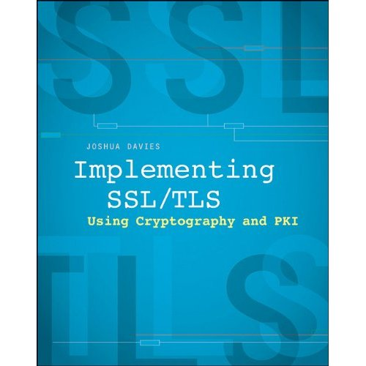
More Information

